Slide 1
Analysis of Cryptosystems in Dark Net Markets
Ryan Bass, Brandon Hill, Ann Nelson
7/17/2018

Slide 2
Dream Market Data
Dark Net Markets (DNMs): Online cybercriminal websites are used for advertising, buying, and selling of illegal products.
The Dark Net Market SQL dataset at www.AZsecure-data.org, was developed by the University of Arizona’s Artificial Intelligence Lab.
The data set contains a product table, and a sellers table. The product table contains Dream Market’s product data from 2013-2017 including product name, category, description, shipping options, shipping departure, shipping destination, price, and payment information for 39,473 products.
The sellers table provides data about Dream Market’s 2,093 sellers who participated on Dream Market from 2013-2017. Attributes in the sellers table include the seller’s name, how long they’ve been a member, pgp_key, seller’s description, and feedback rating.

Slide 3
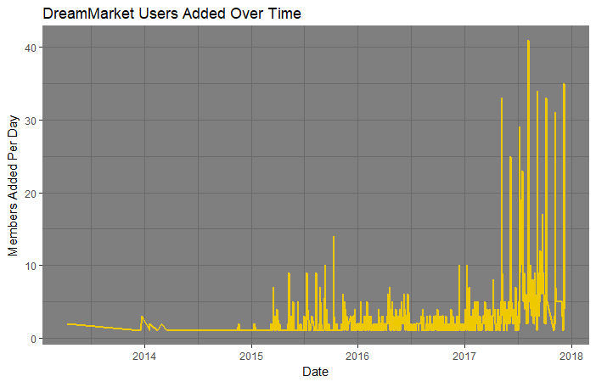
History
Dream Market members added per day. Username data was associated with date the user made account. These time stamps show a marked increase in memberships during the shutdown of AlphaBay and Hansa dark net markets in July 2017.

Slide 4
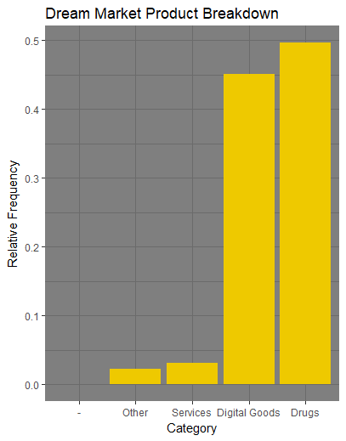
Product Catalog Breakdown
Mining of the database created by University of Arizona Artificial Intelligence Lab yielded three major categories of products;
Drugs - 49.69%
Digital goods - 45.02%
Services - 3.10%
Others - 2.19%

Slide 5
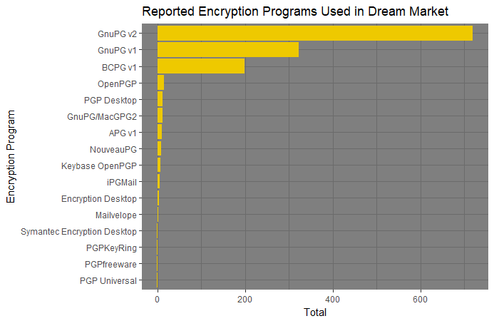
Encryption of Choice - GnuPG
Of the reported encryption programs used by DreamMarket users, versions of GnuPG made up approximately 80% of the encryption programs used on the site. Only BCPG, with approximately 15% usage rate, was the only other program of note being used.
Notes:
GnuPG is an open source encryption suite, we’ll go into more detail in a moment.

Slide 6
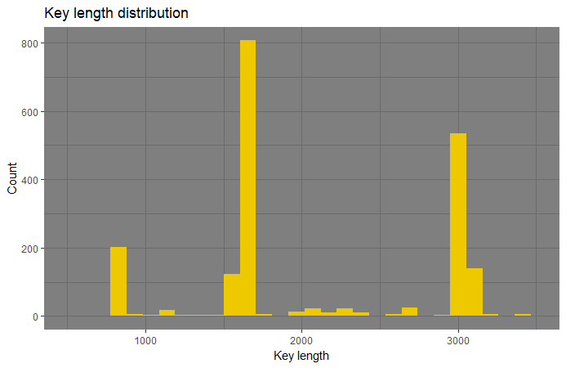
Public Key Lengths
Distribution of public key lengths between 500 and 3500 bit lengths for all users in the dataset. Very few key lengths were longer than 3500 bits, so graph was limited to more appropriately display the most common key lengths.

Slide 7
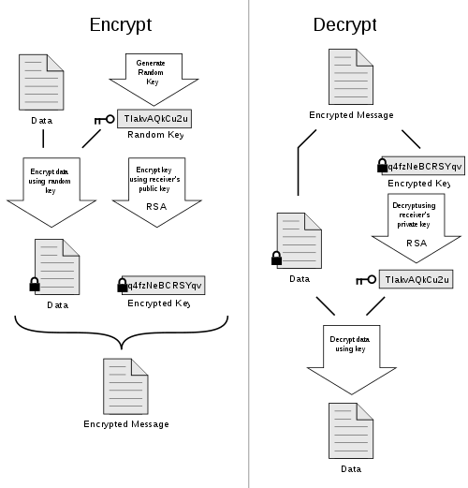
PGP Process Flow
Symmetric key generated
Symmetric key encrypts plaintext/data
Symmetric key is encrypted using public key
Both encrypted data and key sent to recipient
Decrypt key using recipient’s private key
Plaintext/data decrypted using symmetric key
Source Link
Notes:
PGP (pretty good privacy) is a encryption suite made by Symantec. An open source version of it came out called OpenPGP in XXX year, it is a hybrid cryptosystem that utilizes public/private keys as well as symmetric keys. GnuPG is based on OpenPGP.

Slide 8
GnuPG Function to Algorithm Breakdown
GnuPG Functions | GnuPG Supported Algorithms
Public Key | DSA, EIGamal, RSA
Cipher | 3DES, AES-128, AES-192, AES-256, Blowfish, Camellia-128, Camellia-192, Camellia-256, CAST5, IDEA, Twofish
Hash | MD5, RIPEMD-160, SHA-1, SHA-224, SHA-256, SHA-384, SHA-512
Compression | BZIP2, Uncompressed, ZIP, ZLIB
GnuPG can serve as a “one stop shop” for algorithms needed at each step of cryptography.

Slide 9
Public Key Lengths
Public Key Lengths can be attributed to certain algorithms:
ElGamal 768-bit key
Public key at ~1750-bit = ?
RSA or DSA 3072-bit key

Slide 10
Future Work
Predict implications of weak public keys on anonymity of digital goods data and user data in hybrid cryptosystems
Analyze further how smaller key lengths are vulnerable to brute force in hybrid cryptosystems
Analysis on hybrid cryptosystems (ex. GnuPG's) hash functions
Further analysis on BCPG encryption program

Slide 11

Questions

